Slide 2
Enriching Content with Alfresco Intelligence Services(AIS)
Logan Jensen, Technical Trainer

Slide 3
agenda
AIS Overview
AWS AI Services
AIS Setup
Repository Implementation

Slide 4
AIS Overview

Slide 5






What is Alfresco Intelligence Services?
ALFRESCO CONTENT SERVICES
MACHINE LEARNING
ALFRESCO DIGITAL WORKSPACE
T
AI
TEXTRACT
REKOGNITION
COMPREHEND
Notes:
What is Alfresco Intelligence Services? (AIS) for short.
Alfresco Intelligence Services is an add-on module that adds AI capabilities to Alfresco Content Services and the Digital Workspace. It enables you to configure and use custom Machine Learning models (for Natural Language Processing) to enrich the content stored in Content Services and the Digital Workspace. The Machine Learning models are created using Amazon’s AI services such as Textract, Rekognition, and Comprehend.

Slide 6
Ways to Use Alfresco Intelligence Services
Configure Models
Customers can configure custom Machine Learning (ML) models to enrich content stored in Alfresco
Custom Models
Integrate custom ML models that can be mapped to metadata in Alfresco
Custom Entities
Configure custom entities (e.g. product names or job titles) and leverage this data for anomaly checks or specific trends within the content
Define Categories
Define categories and group documents into named categories and automatically classify or categorize them
Search and index
Search and index unstructured content by business context and easily discover it
Notes:
Some of the ways AIS can be used is by using it to
__CLICK__
Configure models to enrich content stored in Alfresco
__CLICK__
Through custom models mapped to metadata in Alfresco
__CLICK__
Through custom entities to identify trends and anomalies
__CLICK__
Through defining categories so you can automate the classification of documents and
__CLICK__
You can search and index unstructured content

Slide 7
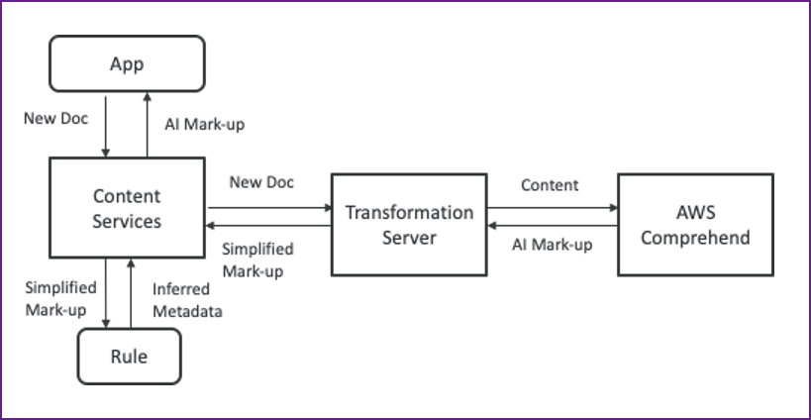
How Does AIS Work? – System Side
Notes:
At a high level, the way AIS works behind the scenes is that it generates insight by taking an item of content that has been uploaded to the Alfresco Content Services (ACS) Repository and passing that content to the AWS Machine Learning Services. The ACS Platform will either do this through the Alfresco Transform Services (ATS) or by direct interaction with the AIS Transform Engines.
The raw output from the AWS Machine Learning Services is then stored as a rendition in the ACS Repository. It can then be processed by parsing it from meta-data, which can be placed in properties or lead to one-time actions.

Slide 8
How Does AIS Work? – Repository Implementation
To trigger AI processing on a folder and extract the metadata for the content within the folder, end users must:
Add an ACS Rule
Add the appropriate AIS aspect(s)
Notes:
When it comes to the repository side of how AIS works, we have to….
__CLICK__
Add an ACS Folder Rule to create an AIS rendition. The rendition stores the results from processing in the AWS Machine Learning Services. Then you must…
__CLICK__
Add the appropriate AIS aspect(s) to provide the properties needed to store any extracted meta-data.
This is the portion that we will focus on when we get to the hands-on section of our session.
What you’ll notice is when we add rules, we will trigger AI processing with our request for AI renditions and our AI aspects. The rendition stores and normalizes the entire JSON AI output from AWS. The aspect extracts metadata from the rendition.

Slide 9
AWS AI Services
Notes:
AWS AI Services
We’ll go over at a high level the main services that Alfresco connects with in AIS. They include Comprehend, Rekognition, and Textract.

Slide 10






Amazon Comprehend
Uses Natural Language Processing (NLP) to extract insights about the content of your documents.
People
Products
Events
Places
Dates
Organizations
Notes:
Comprehend uses Natural Language Processing (NLP) to extract insights about the content of your documents.
As Comprehend analyzes your documents, it develops insights for entities like people places, and locations, key phrases, PII, the dominant language being used in a document, sentiment, and syntax analysis where it tells you the part of speech for words in a sentence.
In the example we will do later, we will use PII Detection. Amazon has a universal list of PII entity types like age, credit/debit card number, and bank account number to name a few.
Reference:
https://docs.aws.amazon.com/comprehend/latest/dg/concepts-insights.html

Slide 11
Amazon Rekognition
Activities
Inappropriate Content
Uses machine learning models to make image and video analysis easy
Landmarks
Objects
Notes:
Rekognition is used for image and video analysis.
__CLICK__
It can identify objects, people, text in images, landmarks, activities, as well as detect any inappropriate content.
Reference: https://aws.amazon.com/rekognition/faqs/

Slide 12


Amazon Textract
Extracts text and data from scanned documents and makes it easy to add document text detection and analysis to your applications.
Course | Instructor
Calculus | Dr. Wrenn
Notes:
Textract extracts text and data from documents. When a document is processed, the results are returned in an array of block objects that can be accessed and manipulated via scripts to obtain your business objectives. Forms, invoices, tables, and text including handwritten text can be analyzed and extracted.
Reference: https://docs.aws.amazon.com/textract/latest/dg/how-it-works-analyzing.html
https://aws.amazon.com/textract/faqs/

Slide 13
AIS Setup
Notes:
In this section we will cover a high-level overview of what is needed to get Alfresco Intelligence Services setup.

Slide 14
Installation
Prerequisites
AWS Services Setup
Amazon AI Services Setup
Zip File
Configure AWS IAM
Roles & Permissions
Minimum Confidence Level
S3 Clean up
Intelligence Services AMP Files
Test Deployment
Docker Image Access
AWS Requirements
Limitations
S3 Buckets
Notes:
We can think of the installation process as four phases.
__CLICK__
The first phase is Prerequisites
__CLICK__
There are several things to complete in this phase….
Test Deployment
Be sure to Test your Deployment with non-AI transformers to ensure everything works.
You’ll always need to make sure you check the Supported platforms page to ensure the version of Intelligence is supported by your company’s versions of Content Services, Transform Service and the Digital Workspace.
Docker Image Access
Quay.io is the private registry that houses Docker images that are used by the Intelligence Services module. It will require that you submit a ticket to Alfresco Support requesting Quay.io credentials so that you can pull the private (Enterprise only) Docker images.
AWS Requirements
You need an AWS account so that you can configure the Amazon AI services that we will touch on shortly.
Limitations
Limitations mean that you will need to check Amazons website for the Regions and Endpoints that are supported as well as the pricing for all the services (whether Comprehend, Rekognition, or Textract) that you plan to use.
S3 Bucket
You need to create a S3 bucket specifically for using Intelligence Services. This bucket needs to be in a common region that is supported by all the AI Services you plan to use.
__CLICK__
The next phase is AWS Setup
__CLICK__
Configure AWS Identity Access Management
AWS IAM(I'M) allows you to control access to AWS services and resources for your users. IAM allows you to create and manage users and groups as well as controlling permissions to AWS resources.
__CLICK__
The third phase is AI Setup
__CLICK__
Roles & Permissions
Each AI Service requires a policy that grants permissions to groups so that they can access the features associated with that service. There are some predefined policies available. The policies used will give roles the access needed for each service.
Minimum Confidence Level
The minimum confidence level represents the level of confidence that each AWS AI service has in the accuracy of the extracted content. The default value is 80%. You can adjust the values as your org sees fit.
S3 Clean up
Files that are written to S3 for processing are removed once processing finishes. If the service is stopped or an uncaught exception is thrown, it can cause files to be left in S3. For this reason, it is recommended to set up a policy to remove objects from the bucket that are older than 1 day.
__CLICK__
The final phase involves a Zip File Installation
__CLICK__
Intelligence Services AMP Files
The Intelligence Services distribution zip file includes all the files required to provide Intelligence Services. You will install the AMP files to an instance of Content Services. You’ll also need a support ticket through Hyland to get this file.
After you’ve done that, there are two Java commands that you need to run in the Module Management Tool (MMT)

Slide 15
Configure
Default Configuration
Custom Configuration
1
Export Environment Variables
Custom Entity Recognition
2
Add AI Transform Engine
Custom Document Classification
3
Override Transform Router Configuration
Custom Metadata Extraction
4
Override Digital Workspace Configuration
Notes:
The default configuration (aka OOTB) consists of four steps to deploy Intelligence Services.
__CLICK__
Step 1 is [read step] which requires you to export your AWS credentials and other settings.
__CLICK__
Step 2 is [^] which requires you to add some configuration logic into your deployment.
__CLICK__
Step 3 is [^] which requires the addition of configuration logic into your deployment that adds extra environment variables in the router config so it’s aware of the new AI Transform Engine.
__CLICK__
Step 4 is [^] which requires adding some configuration logic that overrides the existing settings for the Digital Workspace.
----------------------------------------------
Custom configuration allows you to create custom ML models. The custom models map each model to metadata in your business documents. The following are the available options:
__CLICK__
1. Where you configure and deploy a custom AI recognizer. This allows you to identify new entity types that aren’t supported by one of the preset entity types.
__CLICK__
2. Where you configure and deploy a custom AI classifier. This allows you to classify documents, for example as either an invoice, purchase order, contract, or whatever fits your business model.
__CLICK__
3. Where you configure and deploy a custom AI model. This allows you to map basic OCR detected text lines into multi-valued text fields, so they can viewed and searched.
Once you’ve done your installation and configuration, you can move into the end user responsibility in the share site or ADW.

Slide 16
Repository Implementation (Hands-on)

Slide 17
Environment & Resources
Go to Github – github.com/instructoracct
Download Workbook & AIS Resources
Extract zip file to the Desktop or Downloads folder
Go to class environment: http://23.31.143.2
Notes:
Username and passwords: Name tags should be at each seat. If not, manually assign them.
Test users follow username format: test1,test1a,test1b

Slide 18
Thank you!

